Slide 1
Joint Health Insurance Meetings for Union Members employed by ACPS
April 24, 2024
Notes:
Kim will open the meetings with a short welcome and introduce herself and Cresta on behalf of ACEA and quickly transition to the next slide.

Slide 2
Employee Unions of the ACPS
UNIT 1
Certificated Teachers and Licensed Professional Service Providers
AND
UNIT 4
Education Support Professionals
UNIT 2
Certificated Principals and Supervisors
UNIT 3
Employees of
Food Service
Maintenance
Operations
Notes:
Once Cresta is introduced, she can cover the information about the ACEA Units, then introduce Dan, who can introduce Tonya, who can then introduce Sarah.
Sarah can introduce Carroll Braun of AFSCME, who can introduce their unit leaders.

Slide 3
The Facts of the Matter…
There have been no plan changes OR premium increases since 2019.
current average annual trend is 7%
All units negotiated a freeze on health insurance for 2022-2023 and 2023-2024.
Healthcare costs exceeded the premiums by 16.5% in 2022-2023.
Healthcare costs to date for 2023-2024 have exceeded these by 21.5%.
Notes:
Dan?? Do you want to discuss these items and our position that health insurance is negotiable???

Slide 4
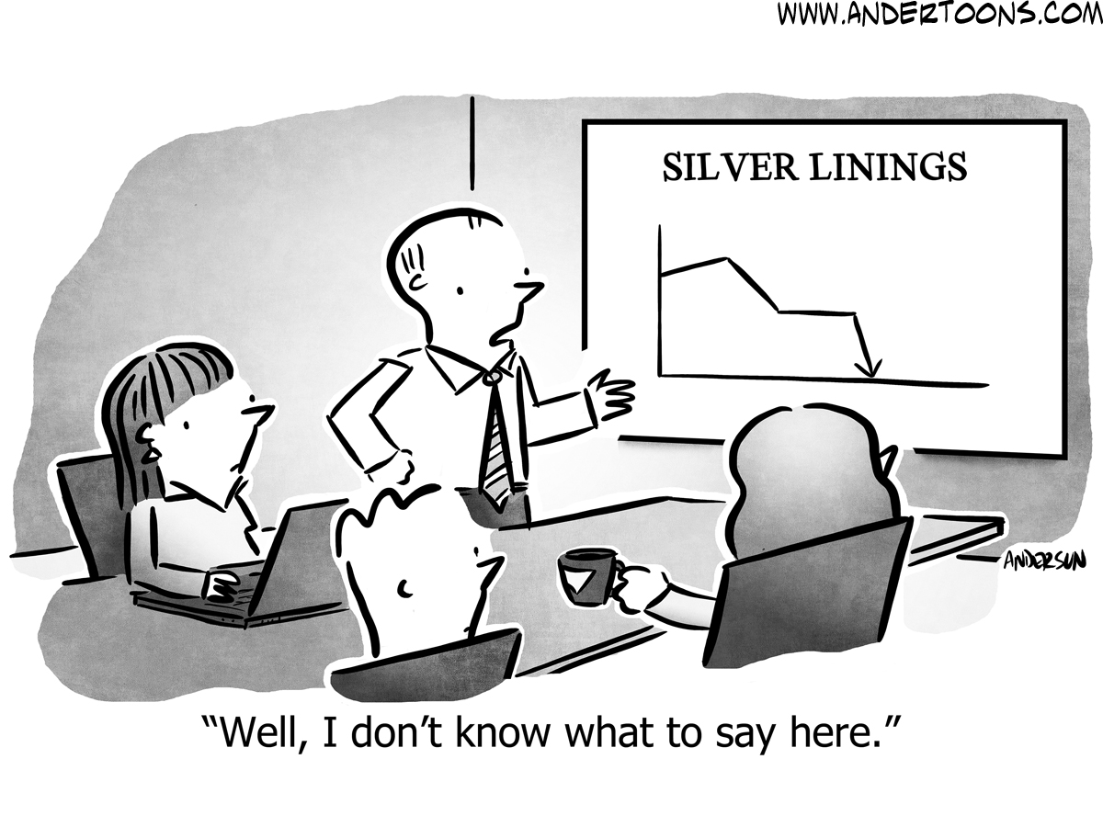
Notes:
Sarah? shares our dismay and frustration with lack of transparency until this late date. She further explains that while it was not our doing that presented the current situation, we began to collaborate as unions to determine what was the best path forward for all of our members.

Slide 5
The Collaboration of Unions
Both the BOE
(82% of cost)
and the employees (18% of cost)
will accept the 22% premium increase with minimal plan changes.
A collaborative healthcare insurance committee will be established starting September 1, 2024, with representation from all unions, and will meet quarterly to review the healthcare data.
The committee will explore the establishment of a Flexible Spending Account (FSA) option for all employees to begin in July 2025, and will educate before implementation.
For an explanation of an FSA:
https://www.investopedia.com/terms/f/ flexiblespendingaccount.asp
Notes:
Dan can continue to share.

Slide 6
The Bottom Line
FULL TIME DEDUCTION | TOTAL BOE ANNUAL PREMIUM | TOTAL EMPLOYEE ANNUAL PREMIUM | BOE COST PER PAY | EMPLOYEE COST PER PAY | EMPLOYEE PER PAY INCREASE OVER CURRENT
Individual | $9,088.71 | $2,272.16 | $454.44 | $113.61 | $19.83
Parent/Child | $15,852.70 | $3,019.54 | $792.63 | $150.98 | $26.05
Employee/Spouse | $20,681.08 | $4,146.13 | $1,034.05 | $207.31 | $35.85
Employee/Spouse BOTH BOE Employees | $21,723.82 | $3,103.38 | $1,086.19 | $155.17 | $26.83
Family | $25,205.45 | $5,950.87 | $1,260.27 | $297.54 | $51.06
Family BOTH BOE Employees | $27,697.94 | $3,458.37 | $1,384.90 | $172.92 | $29.67
Notes:
Carroll (or Kevin?): These are the official calculations shared by the ACPS Finance Department regarding the PER PAY increase for ACPS employees based on the various coverage plans.
You may want to once again stress that while the employee contributions have increased 22%, so has the BOE’s, and which increase totals approximately $3.2 million in additional benefits for our members.

Slide 7
Additional Information…
UNIT 1 AND UNIT 4
Kim Sloane, President
ksloane@mseanea.org
301-729-8280
Cresta Kowalski,
UniServ Director
ckowalski@mseanea.org
UNIT 2
Tonya Detrick-Grove, President
tdetrick-grove@mseanea.org
Dan Besseck, UniServ Director
dbesseck@mseanea.org
UNIT 3
Carroll Braun
cbraun@afscmemd.org
Notes:
Kim will do the wrap up.

